Slide 1

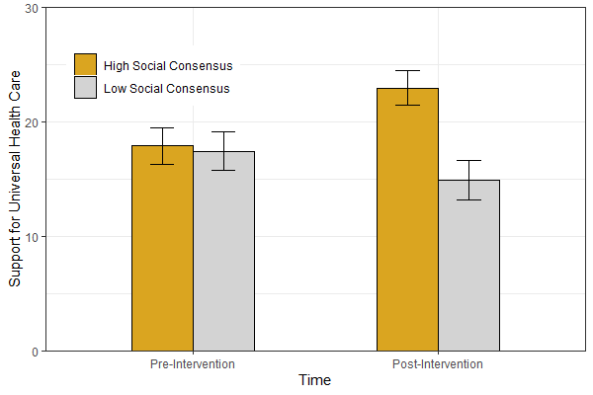
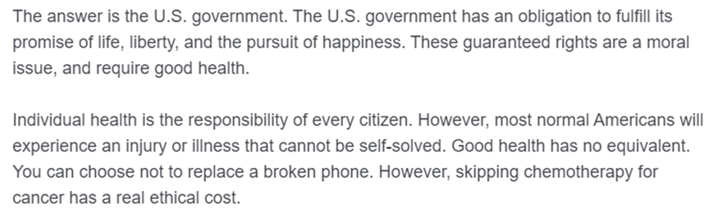
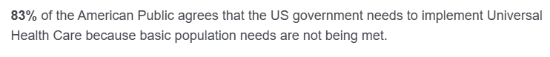
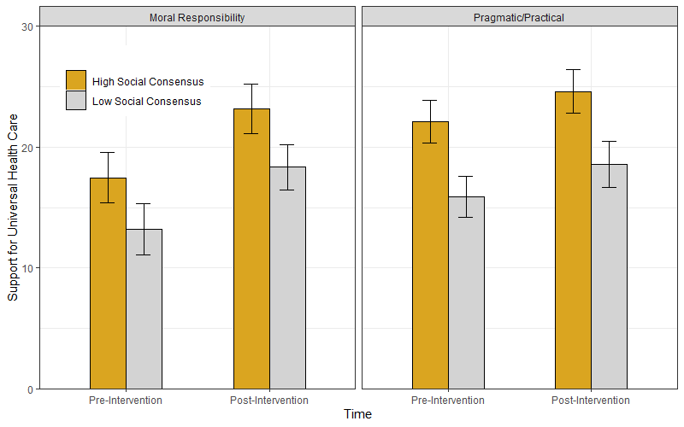
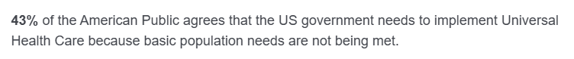
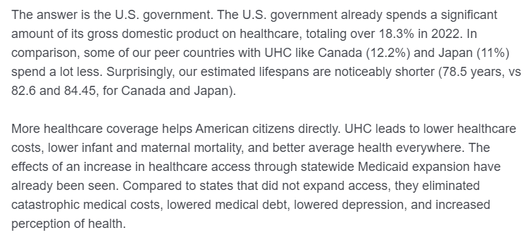
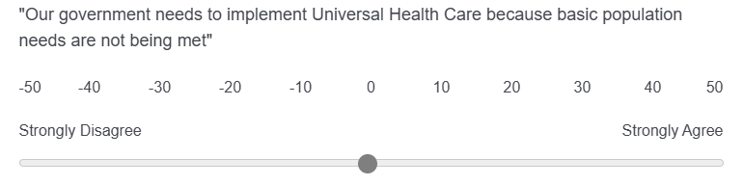

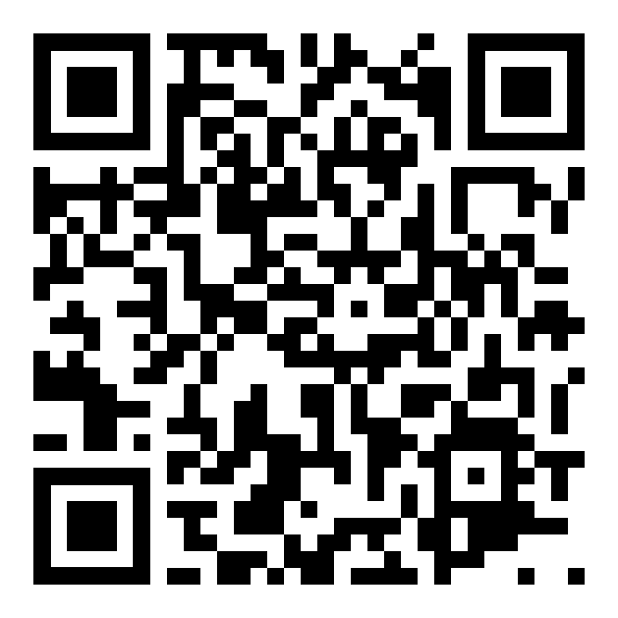





Perception of social consensus but not moral conviction affects support for universal health care
Sean X Duan, PhD., University of Missouri – Columbia: Department of Psychological Sciences
seanxduan@gmail.com
Background and Objective
Results – Study 1
Method – Study 2
The United States is the only 1st world country that does not provide Universal Health Care (UHC) to citizens. Simultaneously, healthcare beliefs in the United States are becoming increasingly polarized
We designed two interventions to increase US support for UHC using psychological theories on polarized belief change (social consensus and moral conviction)
Study 2 replicated and extension to Study 1; Participants (N=491; college students at a midwestern university) were exposed to the same social consensus manipulations, and the outcome measure of support for UHC was the same. For Study 2, participants were also provided one of two moral conviction manipulations
Participants were given an essay centered on moral responsibility (increasing moral conviction)
Or an essay that centered on pragmatic/practical implementation (decreasing moral conviction)
Method – Study 1
Participants (N=505; college students at a midwestern university) reviewed fictitious survey information depicting US public opinion on support for UHC
Using a between-subjects design, participants reviewed survey results that varied in perception of consensus for support, indicating either a HIGH level of social consensus
or LOW level of social consensus on support for UHC
The primary outcome was level of support for UHC, measured both before and after the intervention; Figure 1
Figure 2. Relationship between perception of Social Consensus and Support for Universal Health Care
Results – Study 2
Figure 1. Continuous measure of support for Universal Health Care
Figure 3. Interaction between perception of Social Consensus and exposure to a Moral Conviction manipulation
Discussion
Limitations
Conclusions
Take a picture to download the abstract and poster!
High social consensus condition increases support for UHC across Study 1 and Study 2
No significant main effect of moral conviction manipulation, or interaction with social consensus effect; Figure 3
Moral conviction manipulation was extremely difficult to design in a consistent way that reflected stakeholder preference
Ethical concerns due to manipulating perception of social consensus with fictionalized information
Limited generalizability due to college student participants
American support for Universal Health Care conforms to popular belief, not moral conviction
Simple, low-cost informational interventions highlighting areas where social consensus already exists (e.g., gun-violence prevention ~70% US support) have the potential to be very effective at shifting public support

